Slide 1
MODULE -3
ARTIFICIAL NEURAL NETWORKS

Slide 2
CONTENT
Introduction
Neural Network Representation
Appropriate Problems for Neural Network Learning
Perceptron’s Rule and Delta Rule
Multilayer Networks and BACKPROPAGATION Algorithms

Slide 3
INTRODUCTION
Artificial neural networks (ANNs) provide a general, practical method for learning real-valued, discrete-valued, and vector-valued target functions from examples.

Slide 4
Biological Motivation
The study of artificial neural networks (ANNs) has been inspired by the observation that biological learning systems are built of very complex webs of interconnected Neurons
Human information processing system consists of brain neuron: basic building block cell that communicates information to and from various parts of body
Simplest model of a neuron: considered as a threshold unit –a processing element (PE)
Collects inputs & produces output if the sum of the input exceeds an internal threshold value

Slide 5
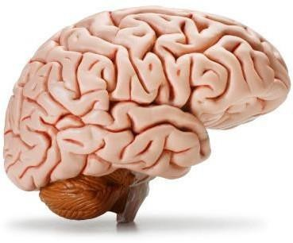

Slide 6
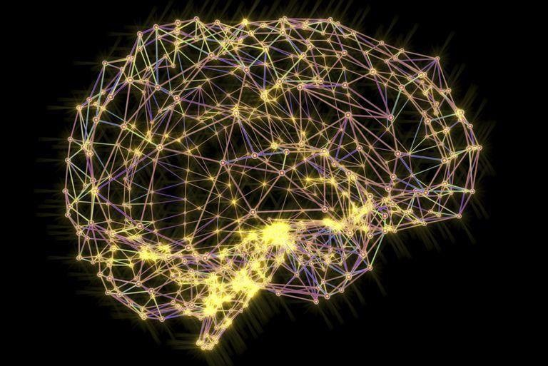

Slide 7
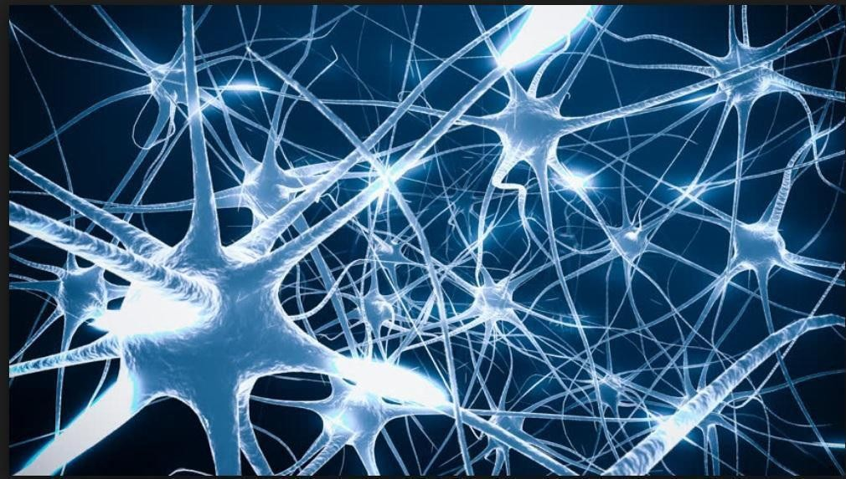

Slide 8
When to consider Neural Networks ?
Input is a high-dimensional discrete or real-valued (e.g., sensor input)
Output is discrete or real-valued
Output is a vector of values
Possibly noisy data
Form of target function is unknown
Human readability of result is unimportant
Examples
Speech phoneme recognition
Image classification
Financial perdition

Slide 9
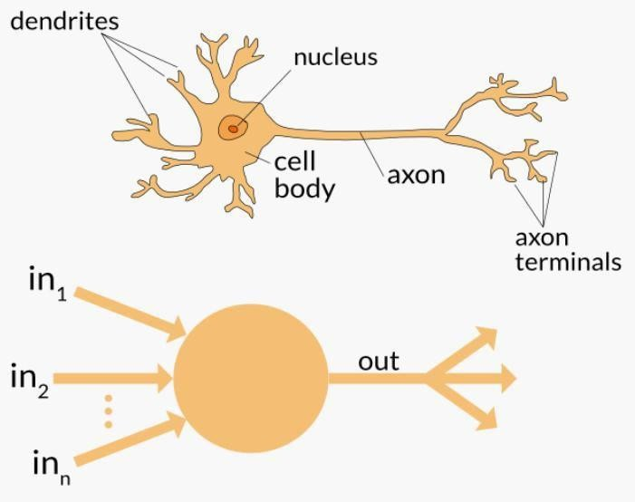
Neuron

Slide 10
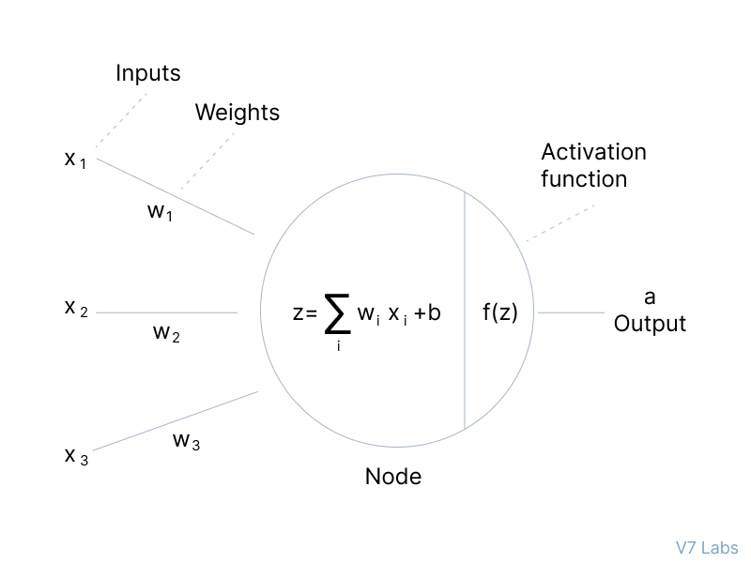
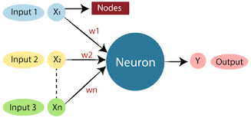
bias

Slide 11
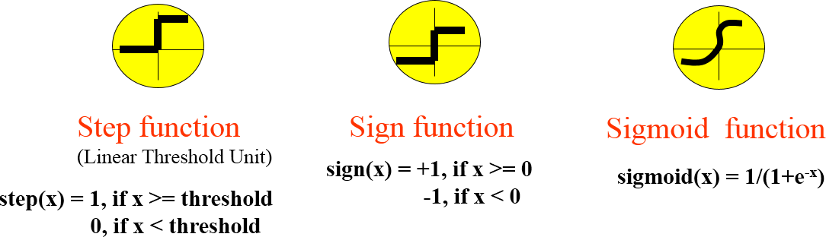
Neuron

Slide 12
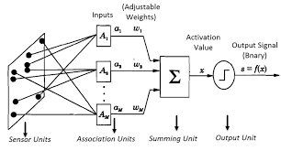
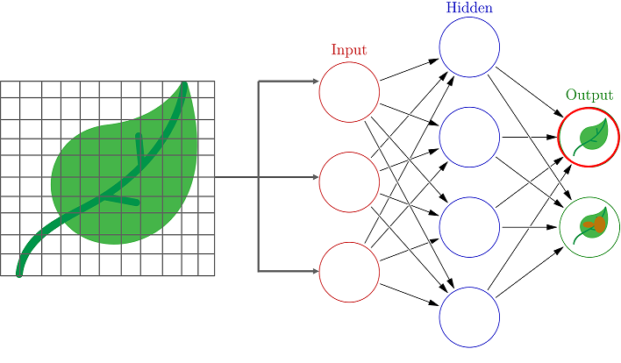
NEURAL NETWORK REPRESENTATIONS

Slide 13
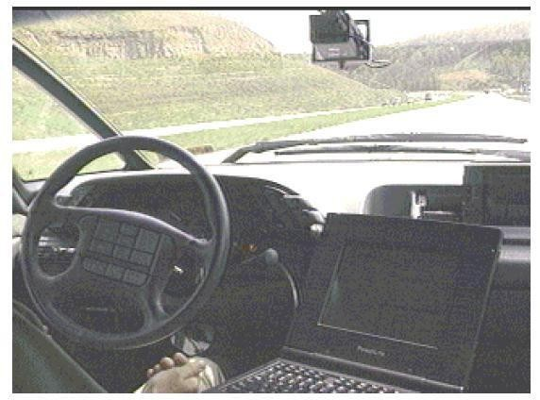
NEURAL NETWORK REPRESENTATIONS

Slide 14
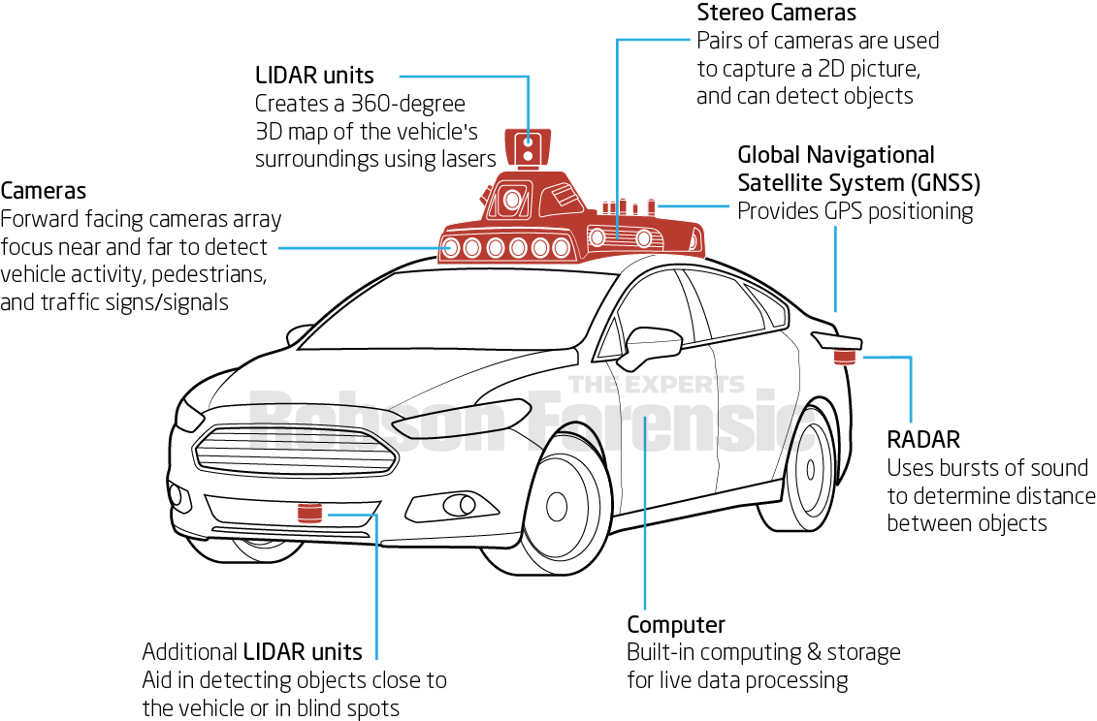

Slide 15
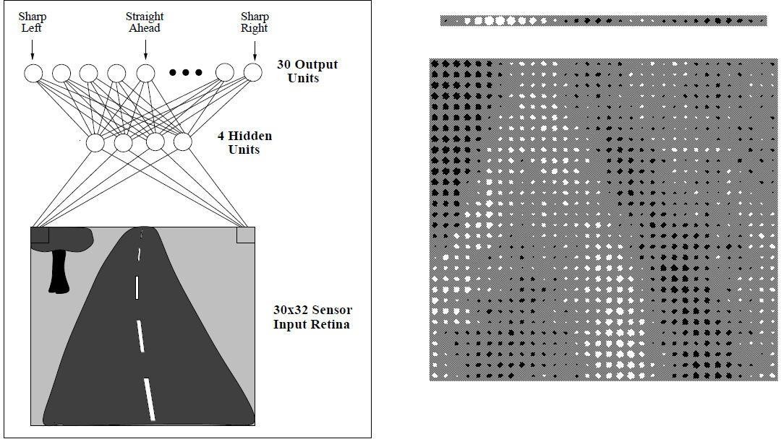

Slide 16
A prototypical example of ANN learning is provided by Pomerleau's (1993) system ALVINN, which uses a learned ANN to steer an autonomous vehicle driving at normal speeds on public highways.
The input to the neural network is a 30x32 grid of pixel intensities obtained from a forward-pointed camera mounted on the vehicle.
The network output is the direction in which the vehicle is steered.

Slide 17
APPROPRIATE PROBLEMS FOR NEURAL NETWORK LEARNING
ANN is appropriate for problems with the following characteristics :
Instances are represented by many attribute-value pairs.
The target function output may be discrete-valued, real-valued, or a vector of several real- or discrete-valued attributes.
The training examples may contain errors.
Long training times are acceptable.
Fast evaluation of the learned target function may be required
The ability of humans to understand the learned target function is not important

Slide 18
Architectures of Artificial Neural Networks
An artificial neural network can be divided into three parts (layers), which are known as:
Input layer: This layer is responsible for receiving information (data), signals, features, or measurements from the external environment. These inputs are usually normalized within the limit values produced by activation functions
Hidden, intermediate, or invisible layers: These layers are composed of neurons which are responsible for extracting patterns associated with the process or system being analysed. These layers perform most of the internal processing from a network.
Output layer : This layer is also composed of neurons, and thus is responsible for producing and presenting the final network outputs, which result from the processing performed by the neurons in the previous layers.

Slide 19
Architectures of Artificial Neural Networks
The main architectures of artificial neural networks, considering the neuron disposition, how they are interconnected and how its layers are composed, can be divided as follows:
Single-layer feedforward network
Multi-layer feedforward networks
Recurrent or Feedback networks

Slide 20
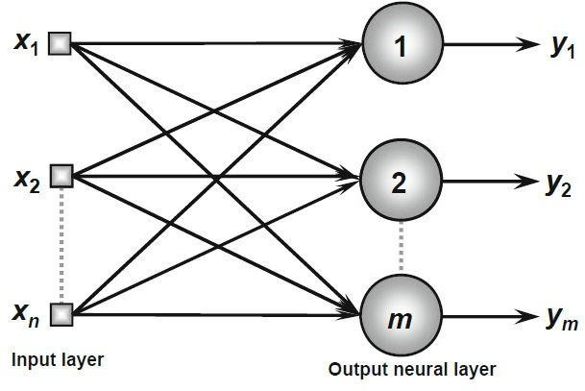
Single-Layer Feedforward Architecture
This artificial neural network has just one input layer and a single neural layer, which is also the output layer.
Figure illustrates a simple-layer feedforward network composed of n inputs and m outputs.
The information always flows in a single direction (thus, unidirectional), which is from the input layer to the output layer

Slide 21
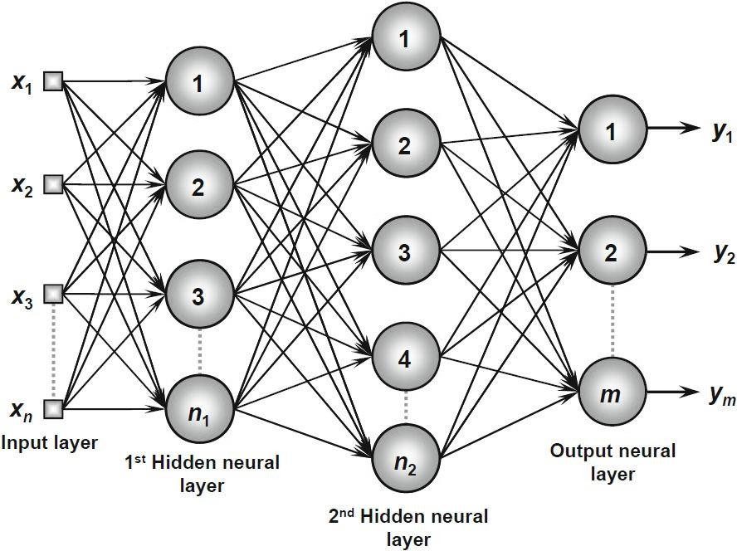
Multi-Layer Feedforward Architecture
This artificial neural feedforward networks with multiple layers are composed of one or more hidden neural layers.
Figure shows a feedforward network with multiple layers composed of one input layer with n sample signals, two hidden neural layers consisting of n₁ and n₂ neurons respectively, and, finally, one output neural layer composed of m neurons representing the respective output values of the problem being analyzed
.

Slide 22
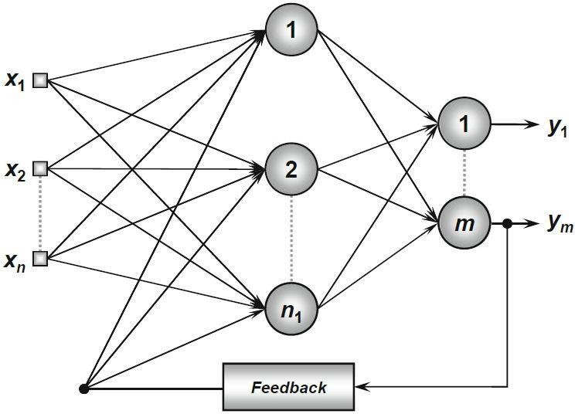
Recurrent or Feedback Architecture
In these networks, the outputs of the neurons are used as feedback inputs for other neurons.
Figure illustrates an example of a Perceptron network with feedback, where one of its output signals is fed back to the middle layer.

Slide 23
Learning Problem
The learning problem is to determine a weight vector that causes the perceptron to produce the correct + 1 or - 1 output for each of the given training examples.
Several algorithms are known to solve the learning problem:
The Perceptron rule
The Delta rule

Slide 24
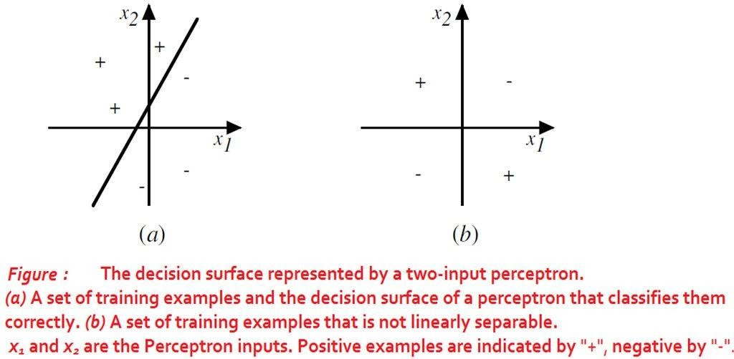
Representational Power of Perceptrons

Slide 25
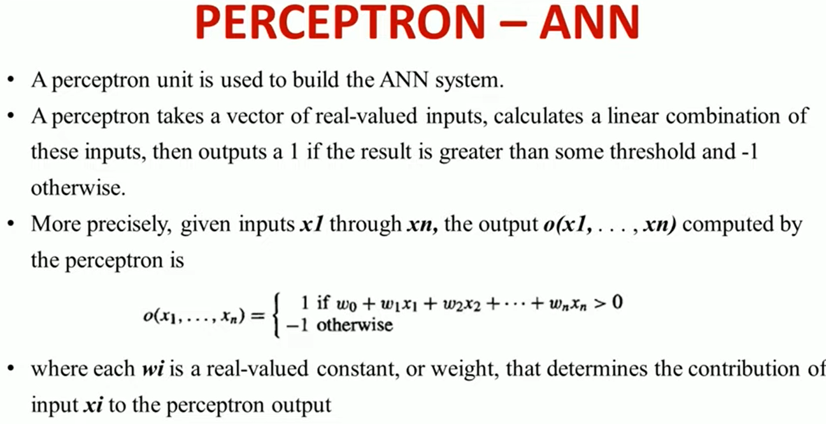

Slide 26
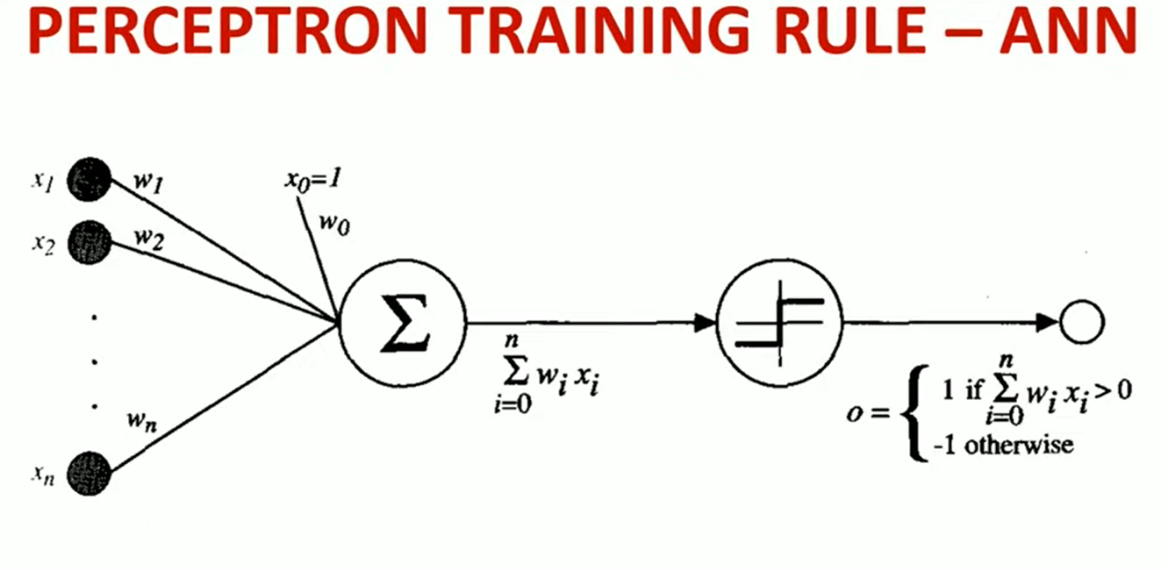

Slide 27
The perceptron consists of 4 parts.
Input value or One input layer: The input layer of the perceptron is made of artificial input neurons and takes the initial data into the system for further processing.
Weights and Bias:
Weight: It represents the dimension or strength of the connection between units. If the weight to node 1 to node 2 has a higher quantity, then neuron 1 has a more considerable influence on the neuron. Weights shows the strength of the particular node.
Bias: It is the same as the intercept added in a linear equation. It is an additional parameter which task is to modify the output along with the weighted sum of the input to the other neuron. A bias value allows you to shift the activation function curve up or down.

Slide 28
Continue…
Net sum: It calculates the total sum.
Activation Function: A neuron can be activated or not, is determined by an activation function. The activation function calculates a weighted sum and further adding bias with it to give the result.

Slide 29
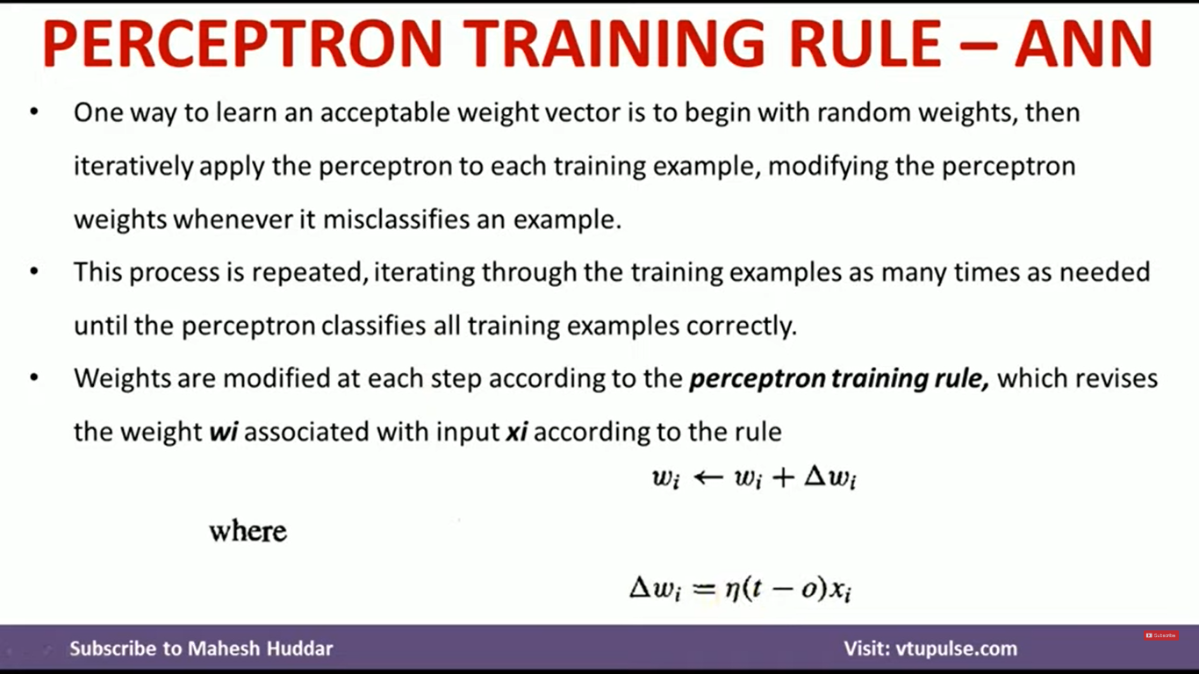
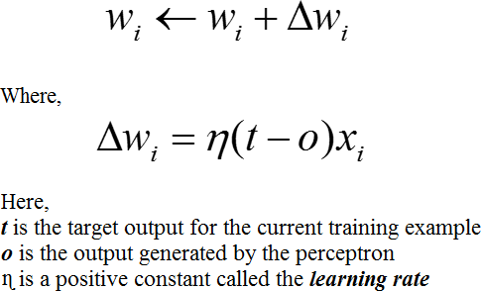

Slide 30
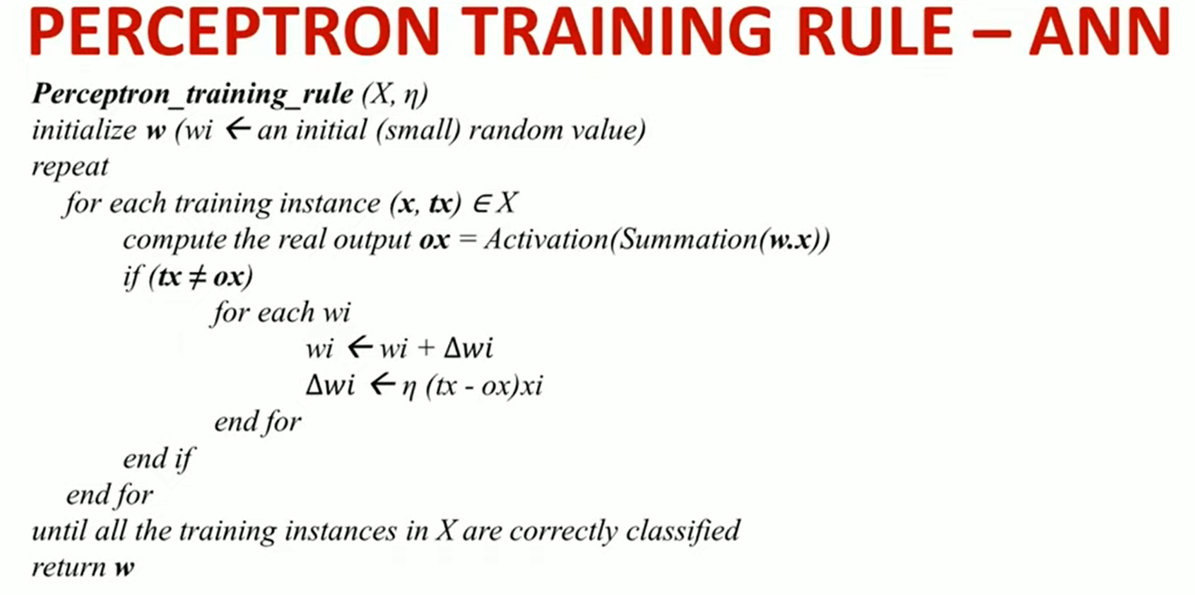

Slide 31
Design a perceptron Network for Logical ‘AND’
Design a perceptron Network for Logical ‘OR’

Slide 32
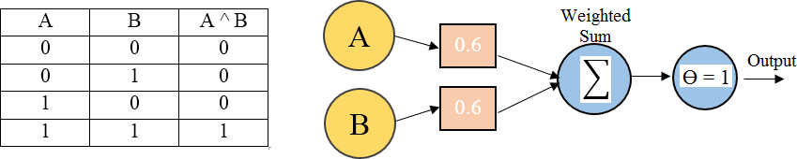
A single perceptron can be used to represent many Boolean functions
AND function
If A=0 & B=0 → 0*0.6 + 0*0.6 = 0.
This is not greater than the threshold of 1, so the output = 0.
If A=0 & B=1 → 0*0.6 + 1*0.6 = 0.6.
This is not greater than the threshold, so the output = 0.
If A=1 & B=0 → 1*0.6 + 0*0.6 = 0.6.
This is not greater than the threshold, so the output = 0.
If A=1 & B=1 → 1*0.6 + 1*0.6 = 1.2.
This exceeds the threshold, so the output = 1.

Slide 33
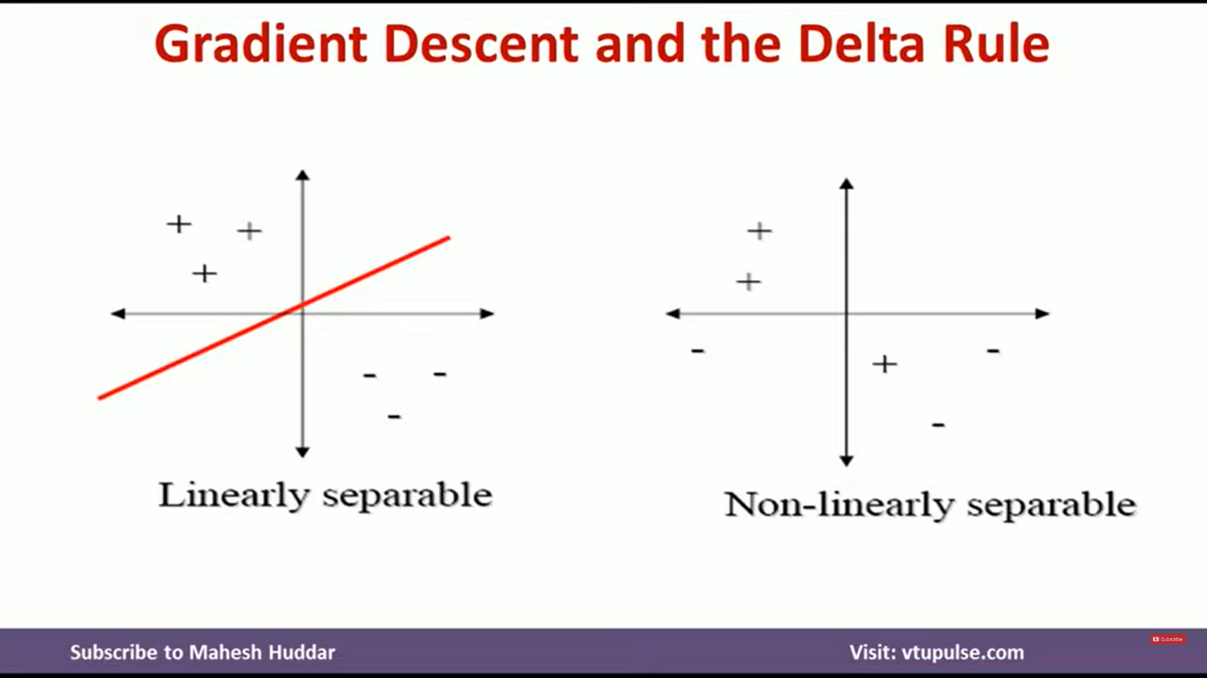

Slide 34
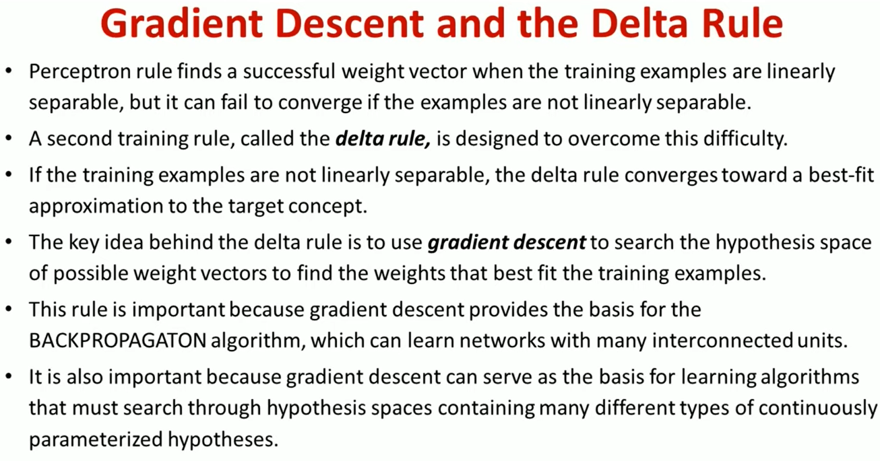

Slide 35
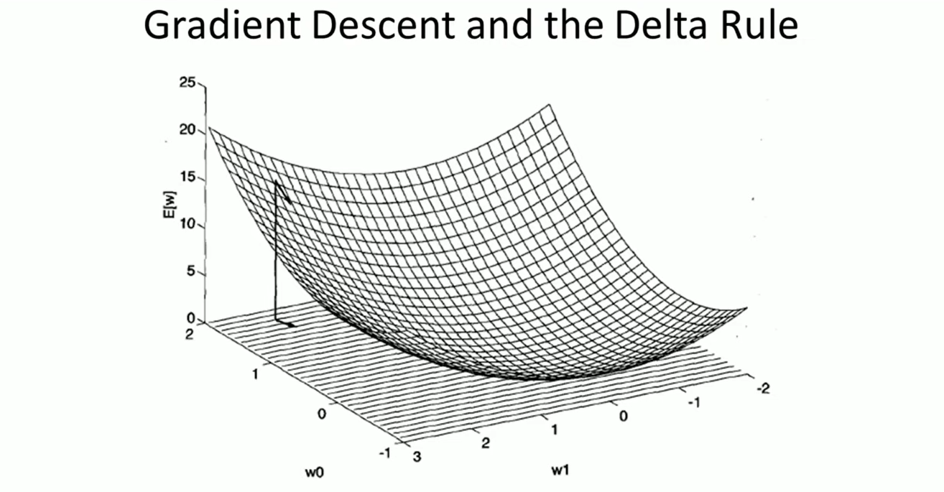

Slide 36
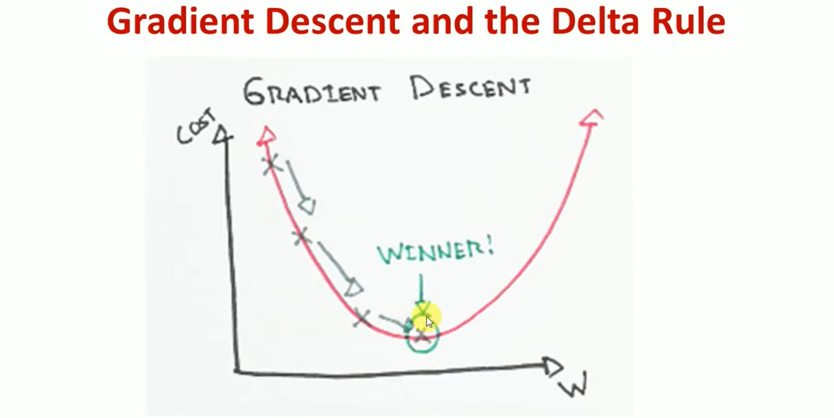

Slide 37
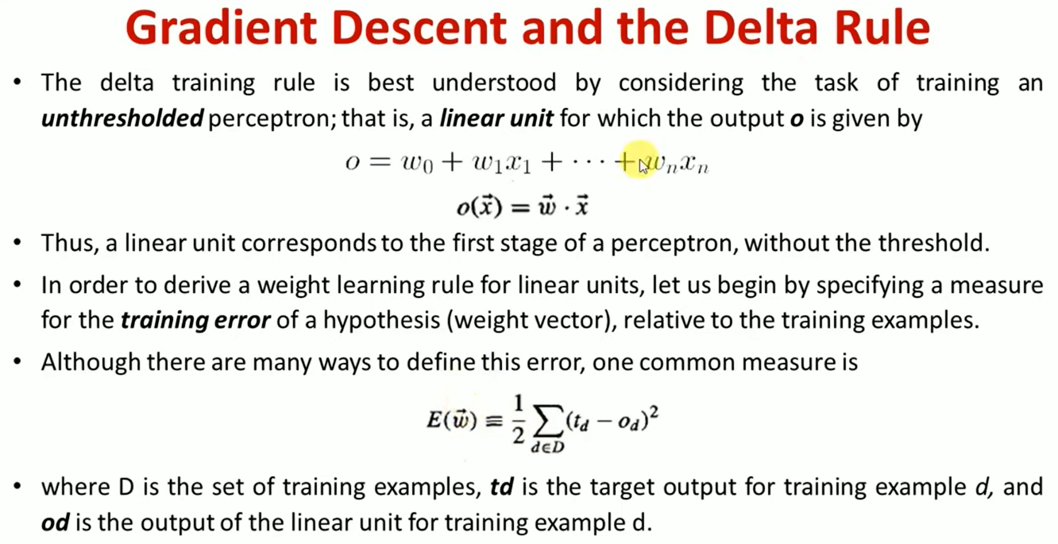

Slide 38
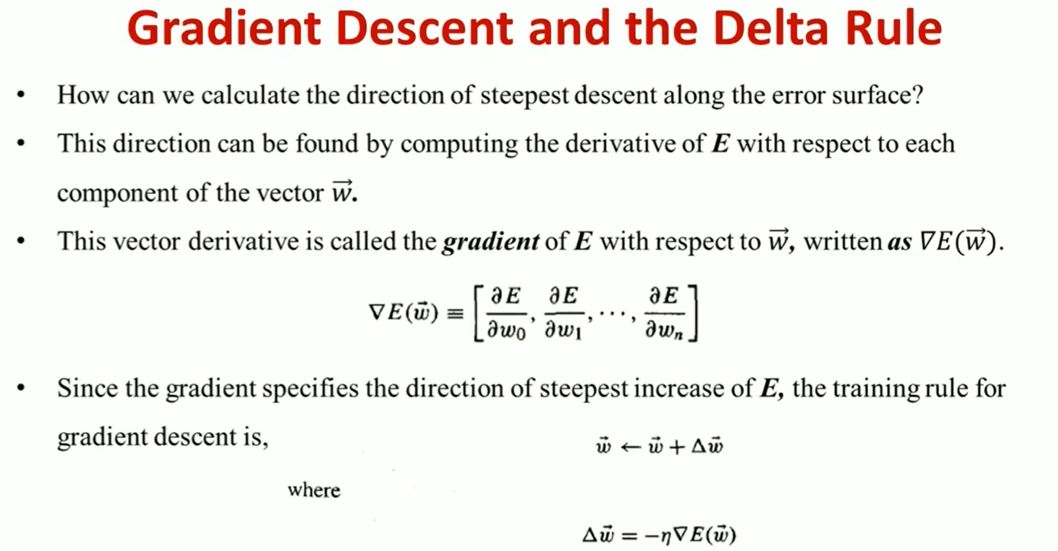

Slide 39
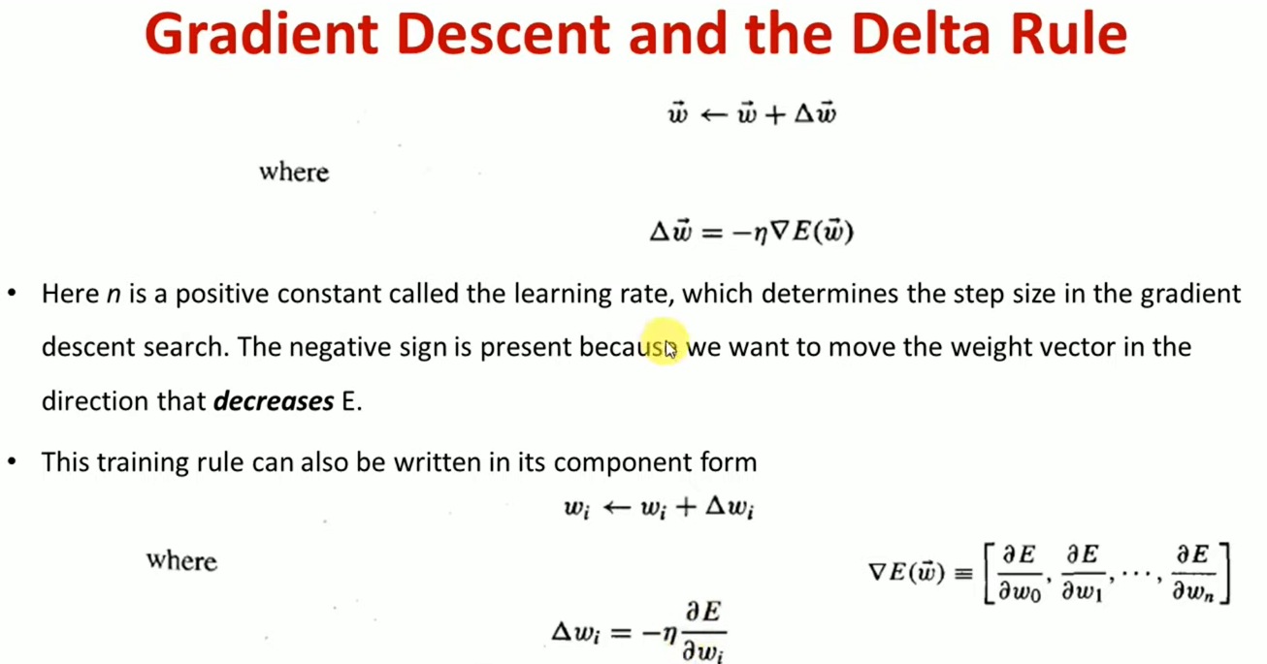

Slide 40
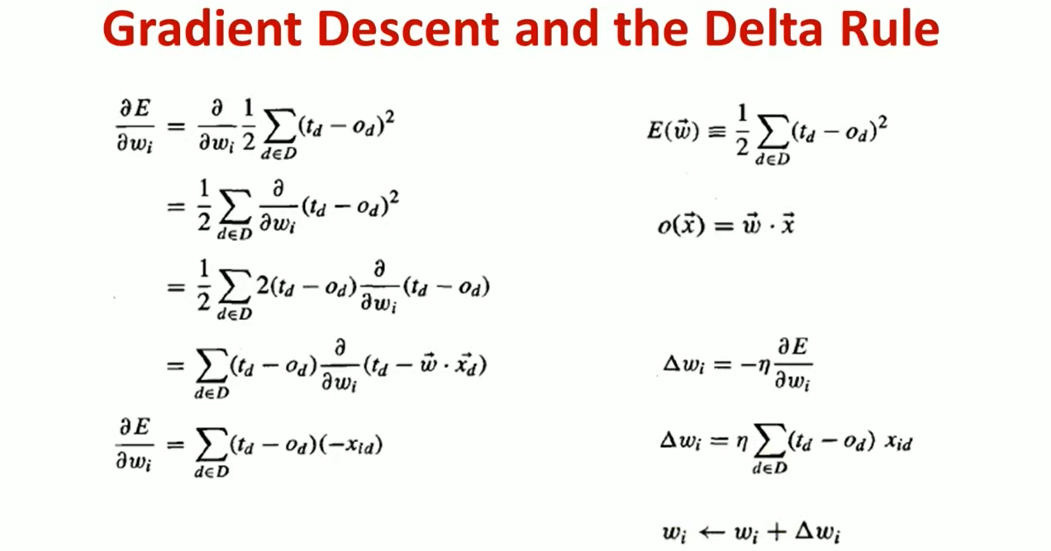

Slide 41
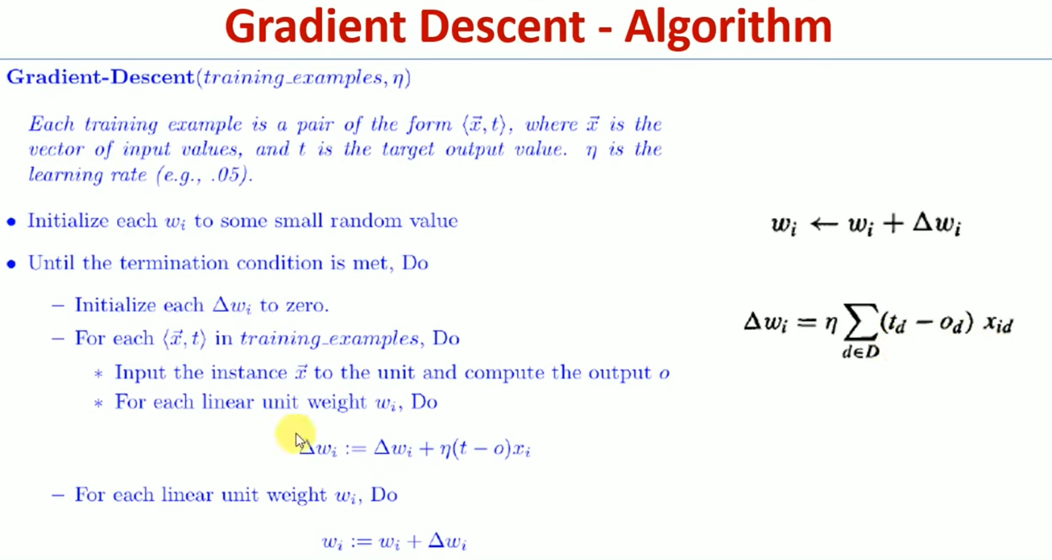
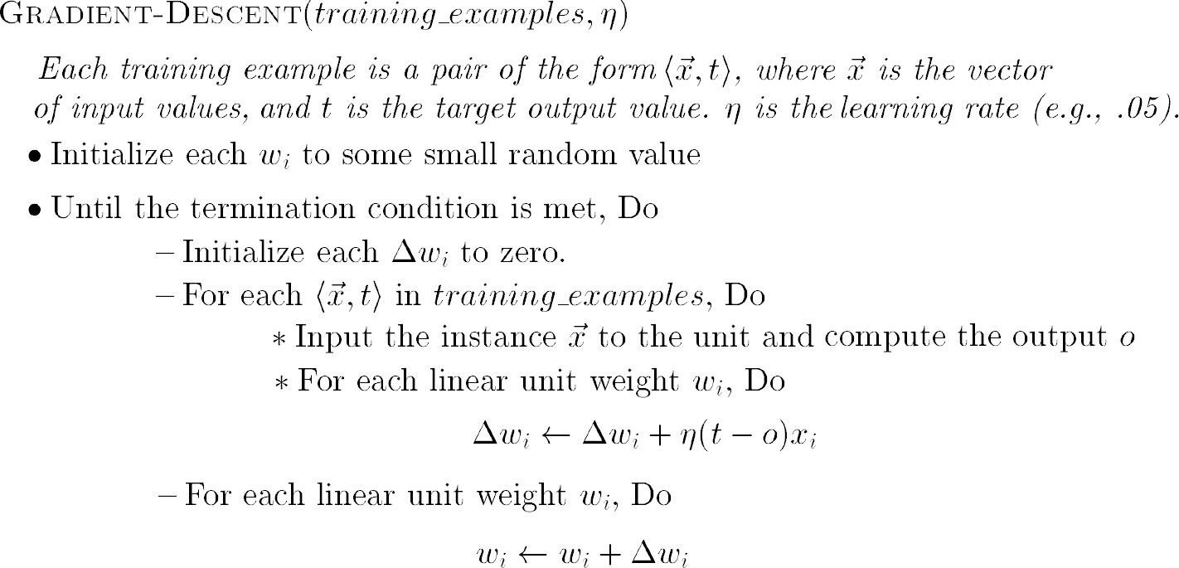
GRADIENT DESCENT algorithm for training a linear unit

Slide 42
Features of Gradient Descent Algorithm
Gradient descent is an important general paradigm for learning.
It is a strategy for searching through a large or infinite hypothesis space that can be applied whenever
The hypothesis space contains continuously parameterized hypotheses
The error can be differentiated with respect to these hypothesis parameters
The key practical difficulties in applying gradient descent are
Converging to a local minimum can sometimes be quite slow
If there are multiple local minima in the error surface, then there is no guarantee that the procedure will find the global minimum

Slide 43
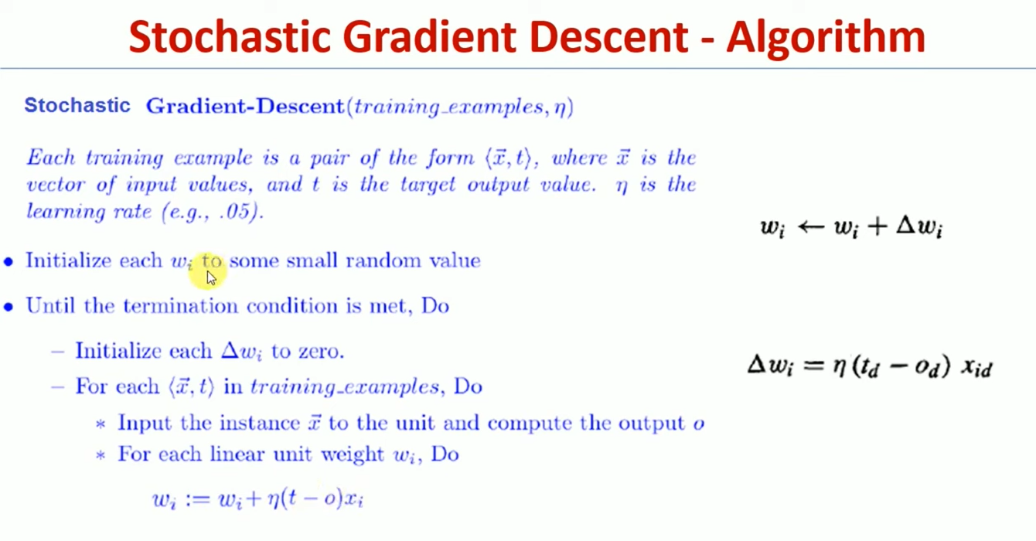

Slide 44
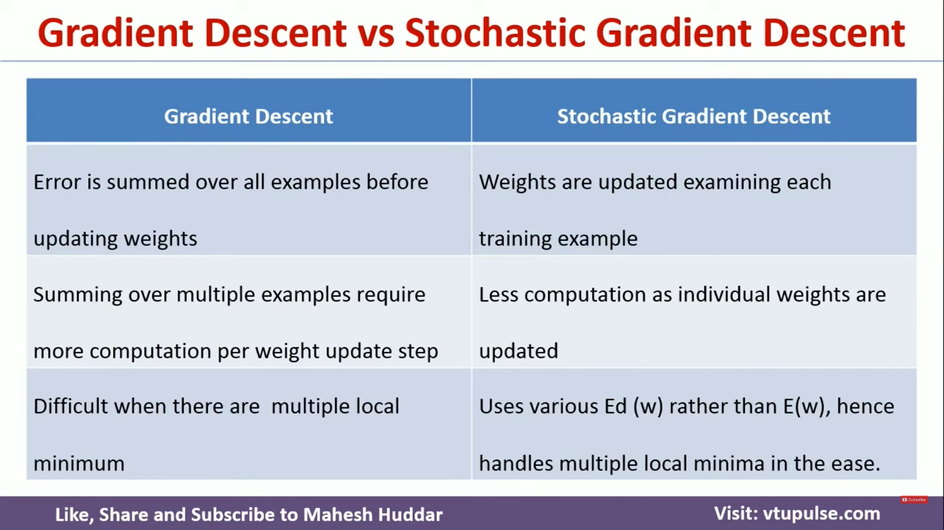

Slide 45
MULTILAYER NETWORKS AND THE BACKPROPAGATION ALGORITHM
Multilayer networks learned by the BACKPROPACATION algorithm are capable of expressing a rich variety of nonlinear decision surfaces

Slide 46
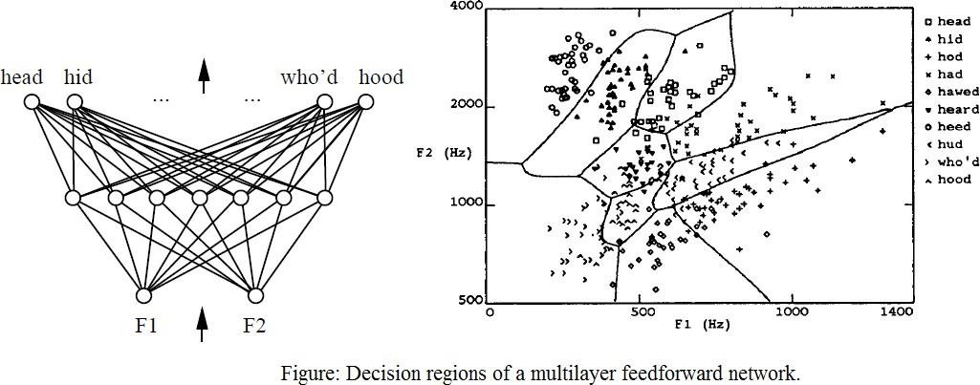
Decision regions of a multilayer feedforward network. The network shown here was trained to recognize 1 of 10 vowel sounds occurring in the context "h_d" (e.g., "had," "hid"). The network input consists of two parameters, F1 and F2, obtained from a spectral analysis of the sound. The 10 network outputs correspond to the 10 possible vowel sounds. The network prediction is the output whose value is highest.
The plot on the right illustrates the highly nonlinear decision surface represented by the learned network. Points shown on the plot are test examples distinct from the examples used to train the network.

Slide 47
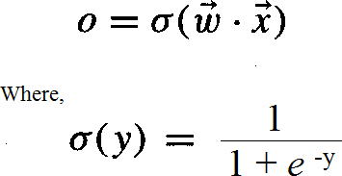
A Differentiable Threshold Unit
Sigmoid unit-a unit very much like a perceptron, but based on a smoothed, differentiable threshold function.
The sigmoid unit first computes a linear combination of its inputs, then applies a threshold to the result. In the case of the sigmoid unit, however, the threshold output is a continuous function of its input.
More precisely, the sigmoid unit computes its output O as
σ is the sigmoid function

Slide 48
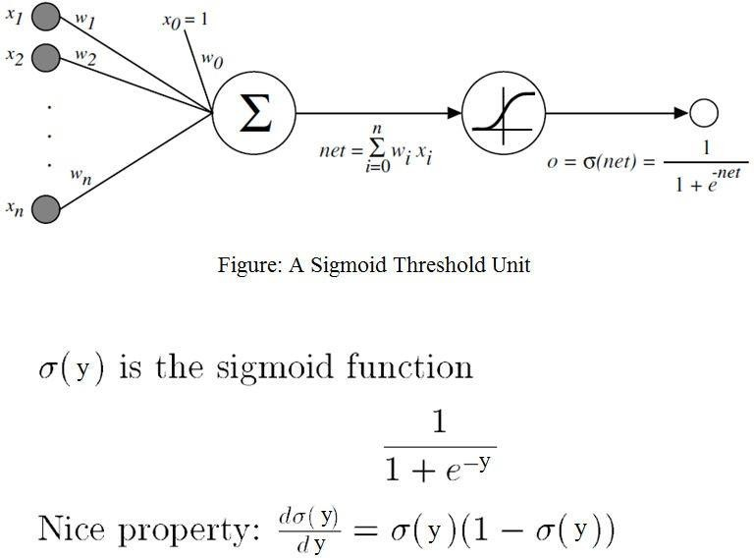

Slide 49
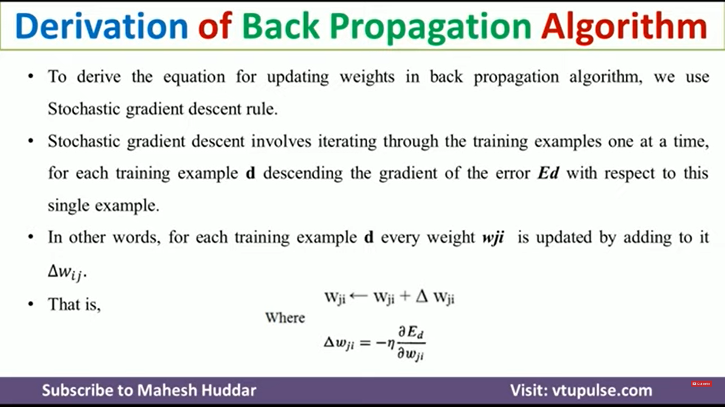

Slide 50
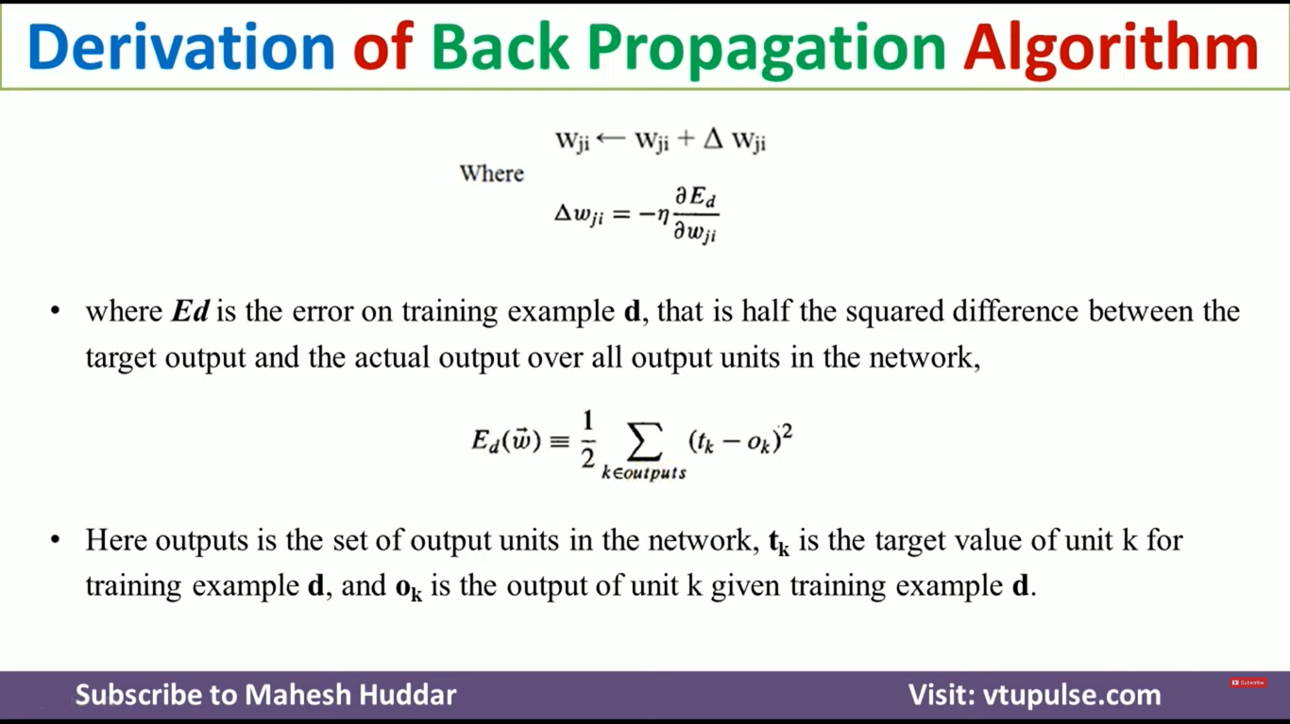

Slide 51
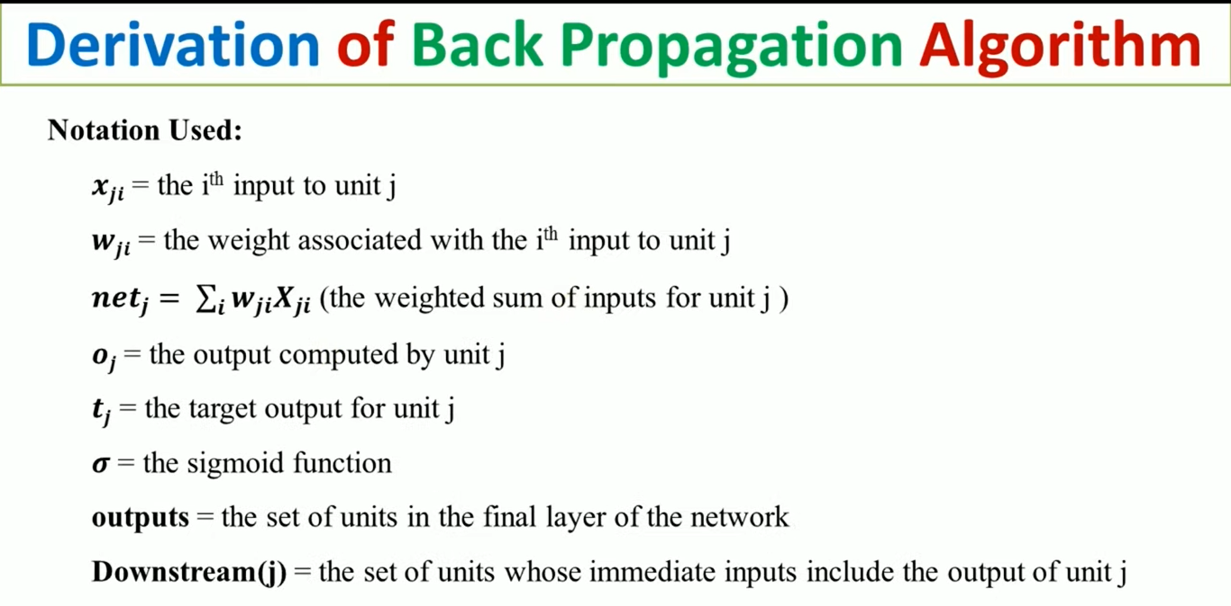

Slide 52
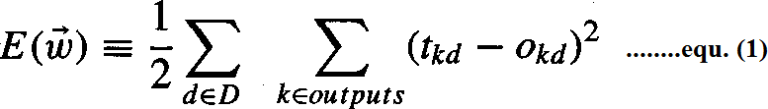
The BACKPROPAGATION Algorithm
The BACKPROPAGATION Algorithm learns the weights for a multilayer network, given a network with a fixed set of units and interconnections. It employs gradient descent to attempt to minimize the squared error between the network output values and the target values for these outputs.
In BACKPROPAGATION algorithm, we consider networks with multiple output units rather than single units as before, so we redefine E to sum the errors over all of the network outputunits.
where,
outputs - is the set of output units in the network
t_{kd} and O_{kd} - the target and output values associated with the k^{th} output unit
d - training example

Slide 53
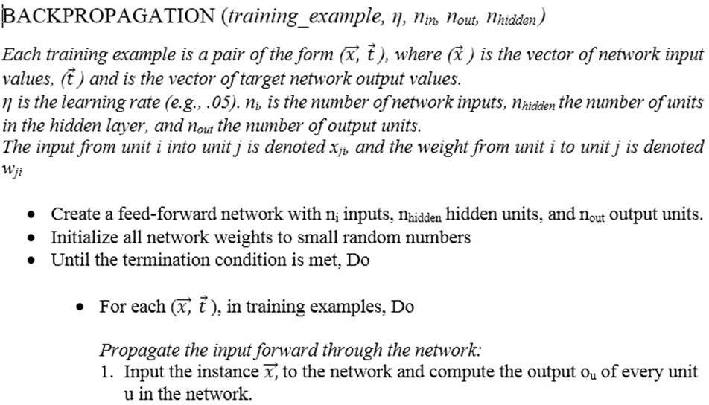

Slide 54
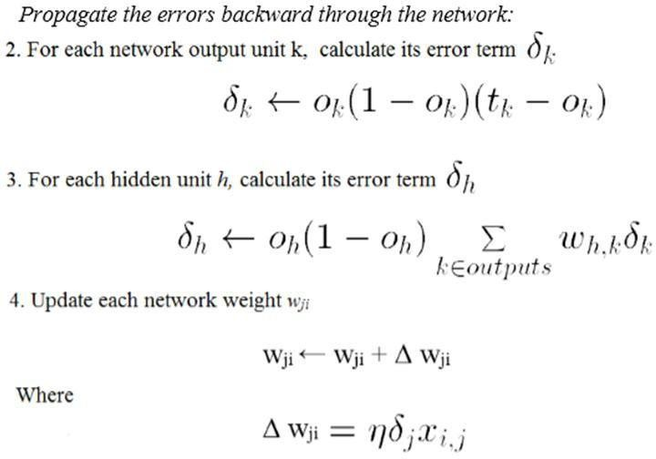

Slide 55
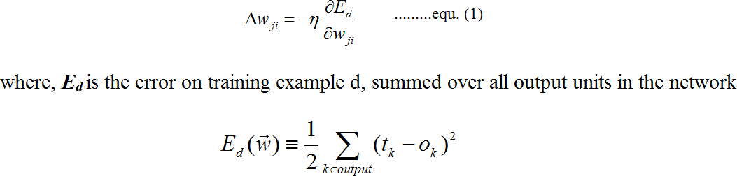
Derivation of the BACKPROPAGATION Rule
Deriving the stochastic gradient descent rule: Stochastic gradient descent involves iterating through the training examples one at a time, for each training example d descending the gradient of the error E_{d} with respect to this single example
For each training example d every weight w_{ji} is updated by adding to it Δw_{ji}
Here outputs is the set of output units in the network, t_{k} is the target value of unit k for training example d, and o_{k} is the output of unit k given training example d.

Slide 56
The derivation of the stochastic gradient descent rule is conceptually straightforward, but requires keeping track of a number of subscripts and variables
x_{ji} = the i^{th} input to unit j
w_{ji} = the weight associated with the i^{th} input to unit j net_{j} = Σ_{i} w_{ji}x_{ji} (the weighted sum of inputs for unit j ) o_{j} = the output computed by unit j
t_{j} = the target output for unit j
σ = the sigmoid function
outputs = the set of units in the final layer of the network
Downstream(j) = the set of units whose immediate inputs include the output of unit j

Slide 57
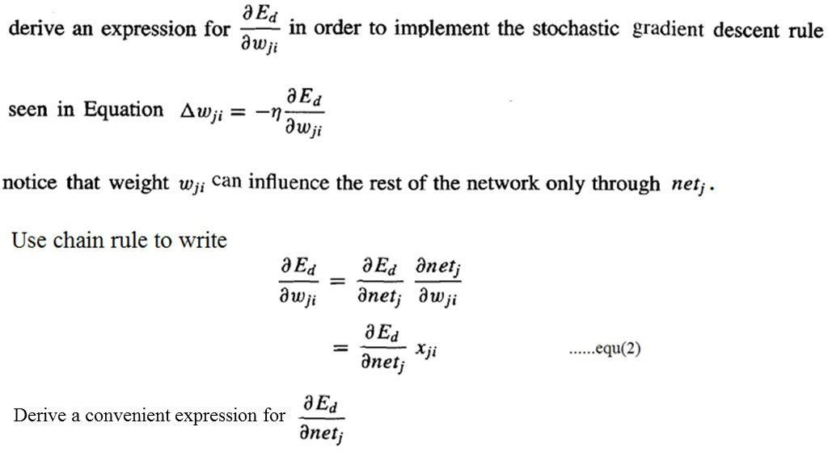
Consider two cases in turn: the case where unit j is an output unit for the network, and the case where j is an internal unit (hidden unit).

Slide 58
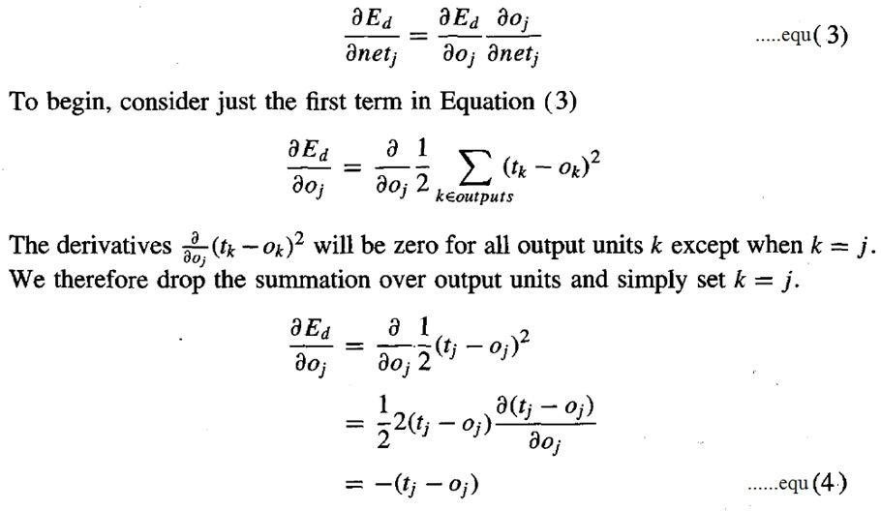
Case 1: Training Rule for Output Unit Weights.
w_{ji} can influence the rest of the network only through net_{j} , net_{j} can influence the network only through o_{j}. Therefore, we can invoke the chain rule again to write

Slide 59
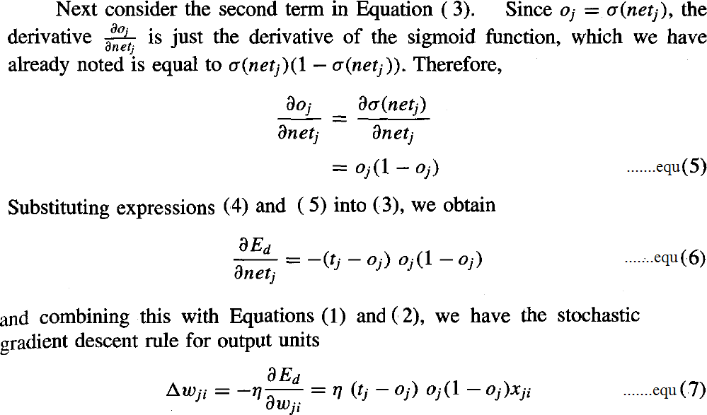

Slide 60
Case 2: Training Rule for Hidden Unit Weights.
In the case where j is an internal, or hidden unit in the network, the derivation of the training rule for w_{ji} must take into account the indirect ways in which w_{ji} can influence the network outputs and hence E_{d}.
For this reason, we will find it useful to refer to the set of all units immediately downstream of unit j in the network and denoted this set of units by Downstream( j).
net_{j} can influence the network outputs only through the units in Downstream(j).
Therefore, we can write

Slide 61
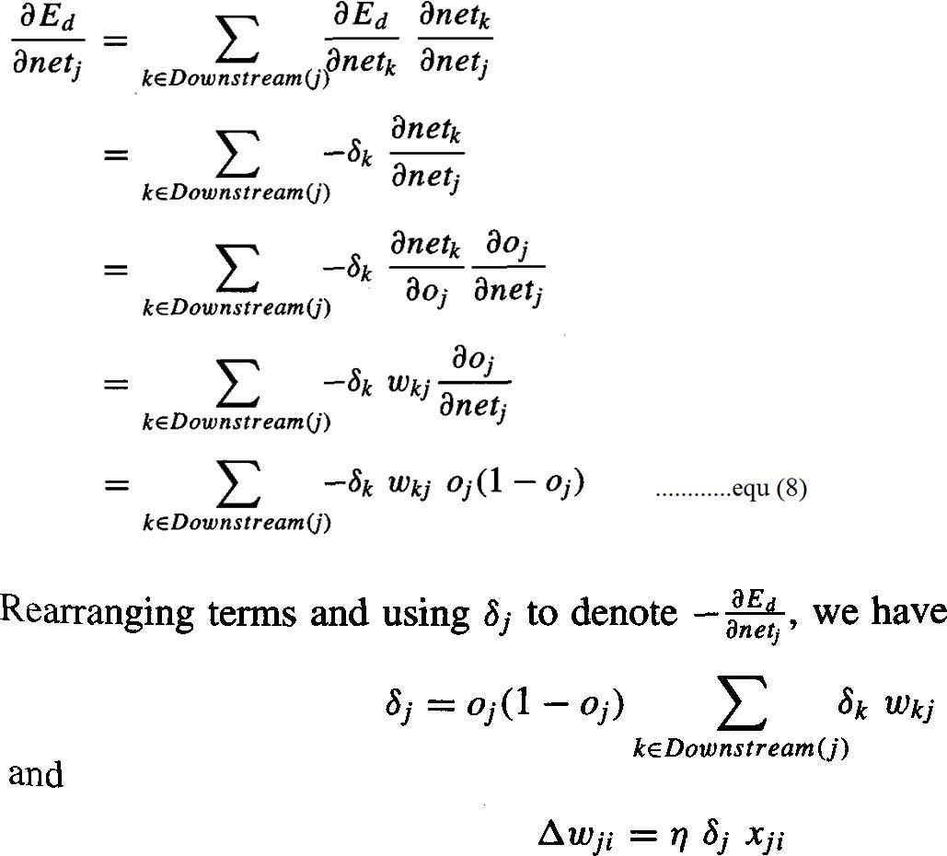

Slide 62
THANK YOU

